Slide 1
Flu Tracker : A web application for flu predictions
CS 5774 User Interface Software Group Project Presentation
Sarang Joshi
Jonathon Hellmann
Vivek Akupatni

Slide 2
Project Overview
Flu tracking system for domain experts
Enables users to
Make flu predictions for region
Refer to CDC flu data for more accuracy
Make connections and follow other domain experts
Visualize predictions

Slide 3
Core Functionality
Features implemented (CRUD operations for users)
Create Users
Make Predictions
Update Predictions
Delete Predictions
View Predictions (List View)

Slide 4
Enhancing the user experience
Interactive visualization
View and modify predictions via click and drag
View actual CDC data and prediction data
Flu Severity Map
Retrieves data from CDC weekly status activity report
External data source
http://www.cdc.gov/flu/weekly/flureport.xml

Slide 5
Social Layer
Features implemented (Social Layer and AMT)
Edit Profile
Follow Users
Administrator role
Use AMT for comparing accuracy of predictions

Slide 6
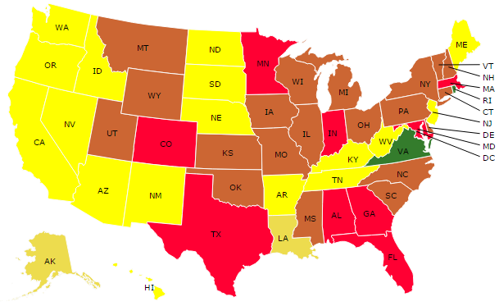
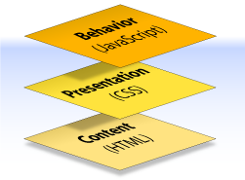
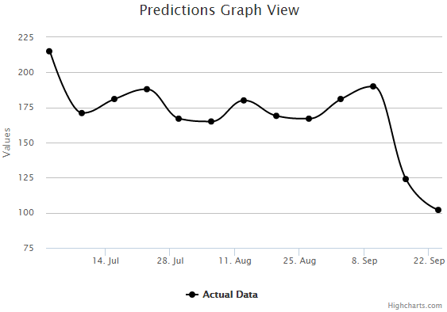
Front-End Architecture
Behavior:
JavaScript
Bootstrap
BootBox – a Bootstrap plugin
jQuery
D3JS
DataMaps – a D3JS plugin
HighCharts – a JS library
Draggable Points – a HighCharts plugin
Presentation:
CSS
Bootstrap
Content
HTML
Uses jQuery, D3JS, DataMaps
Uses jQuery, HighCharts, Draggable Points

Slide 7


Back-End Architecture
Database
MySQL, phpMyAdmin
PHP Classes
PHP
PHP, Apache
Local Deployment: Using XAMPP, localhost
Online Deployment:
Amazon EC2 instance, XAMPP.
URL:
https://ec2-54-69-66-88.us-west-2.compute.amazonaws.com/flutracker/

Slide 8
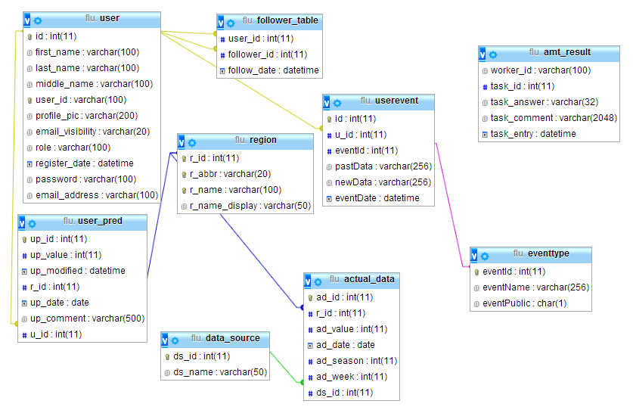
Architecture: ER Diagram

